Slide 1
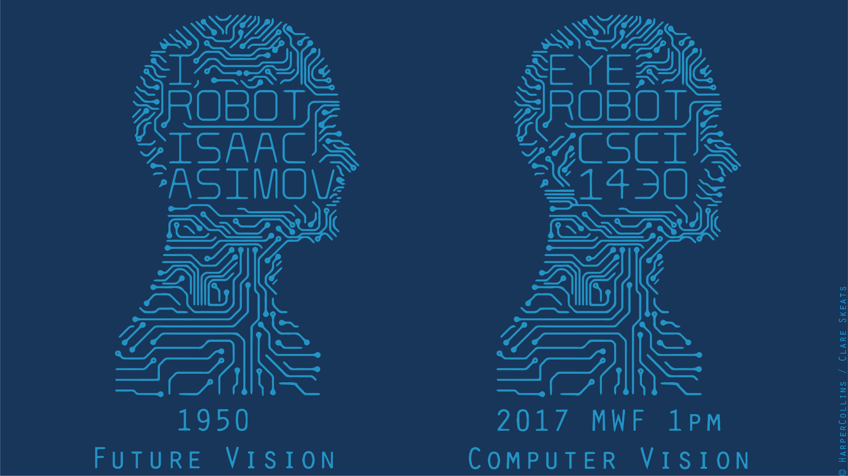

Slide 2
Review of Last Lectures
Applications of filters
Template matching (SSD or Normxcorr2)
SSD can be done with linear filters, is sensitive to overall intensity
Gaussian pyramid
Coarse-to-fine search, multi-scale detection
Laplacian pyramid
Teases apart different frequency bands while keeping spatial information
Can be used for compositing in graphics
Downsampling
Need to sufficiently low-pass before downsampling

Slide 3
Review of Filtering
Filtering in frequency domain
Can be faster than filtering in spatial domain (for large filters)
Can help understand effect of filter
Algorithm:
Convert image and filter to fft (fft2 in matlab)
Pointwise-multiply ffts
Convert result to spatial domain with ifft2
Did anyone play with the code?
Hays

Slide 4
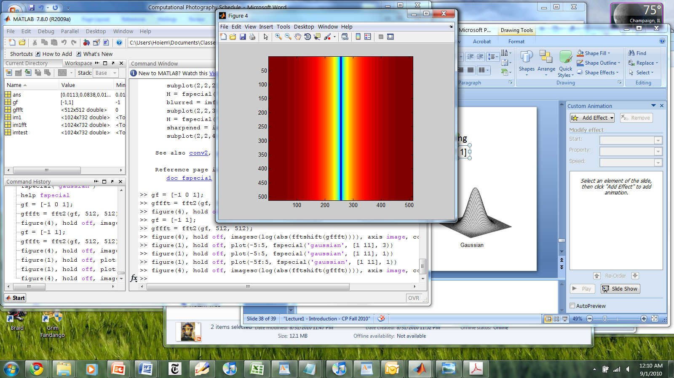
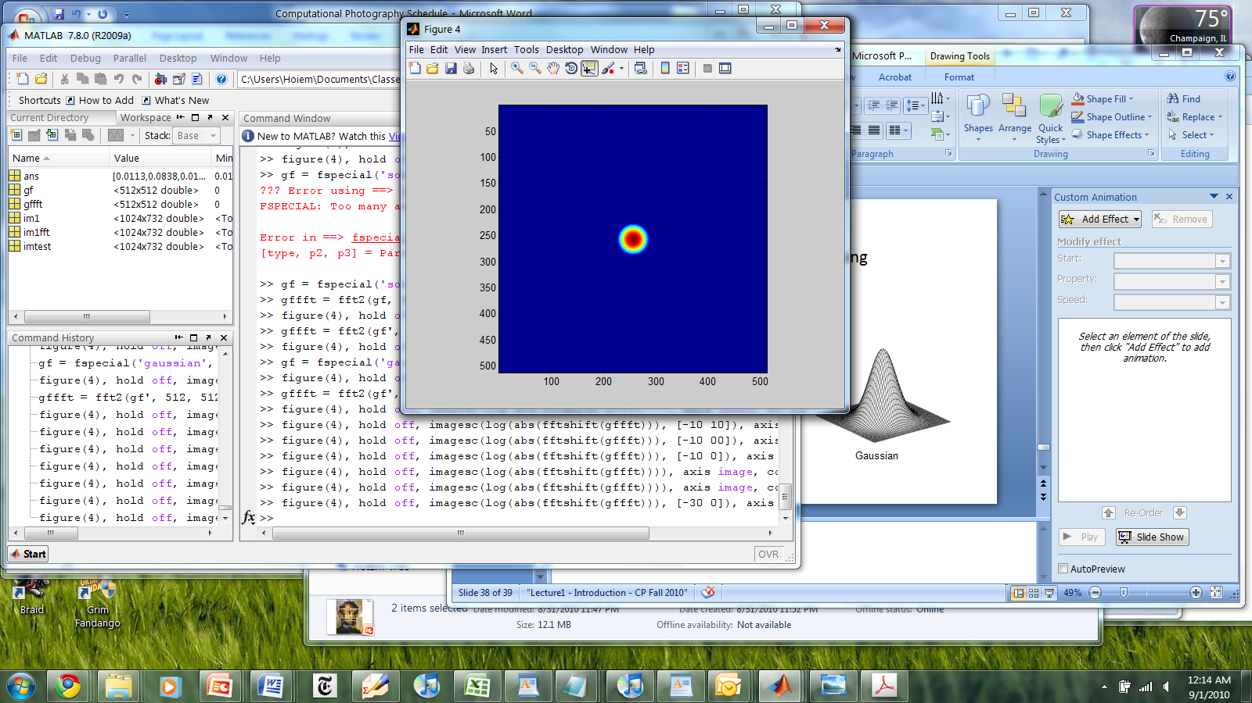
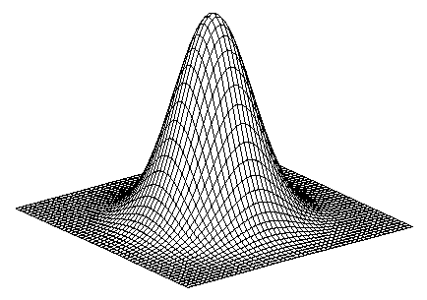
Review of Filtering
Linear filters for basic processing
Edge filter (high-pass)
Gaussian filter (low-pass)
[-1 1]
Gaussian
FFT of Gradient Filter
FFT of Gaussian
Hays

Slide 5
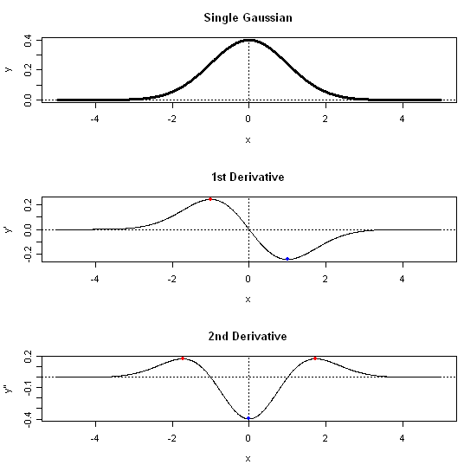
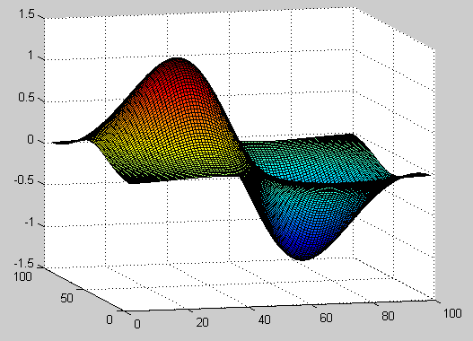
More Useful Filters
1st Derivative of Gaussian
(Laplacian of Gaussian)
Earl F. Glynn
Notes:
http://research.stowers-institute.org/efg/R/Statistics/MixturesOfDistributions/

Slide 6
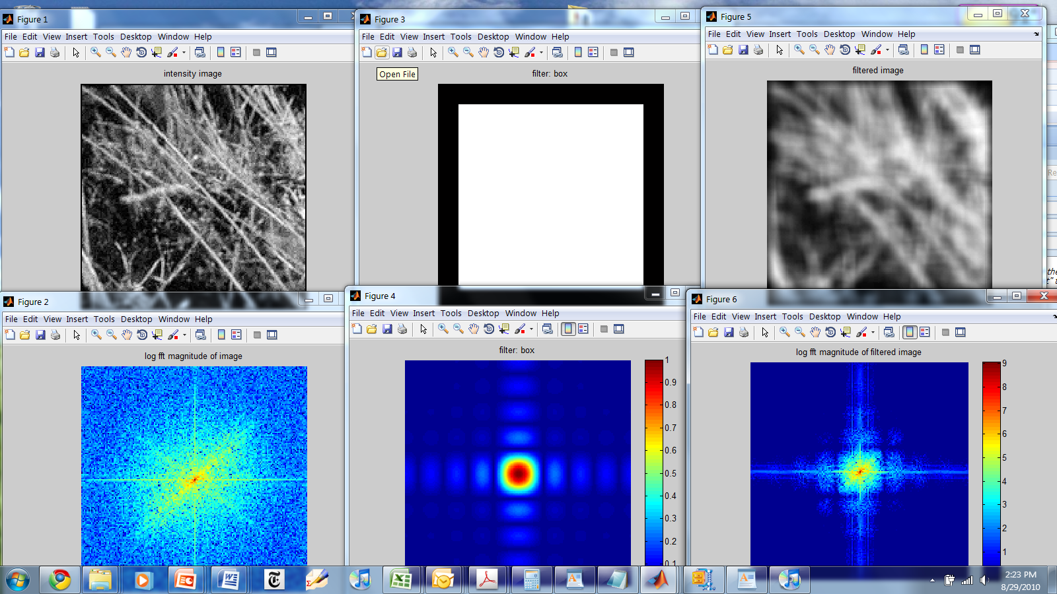
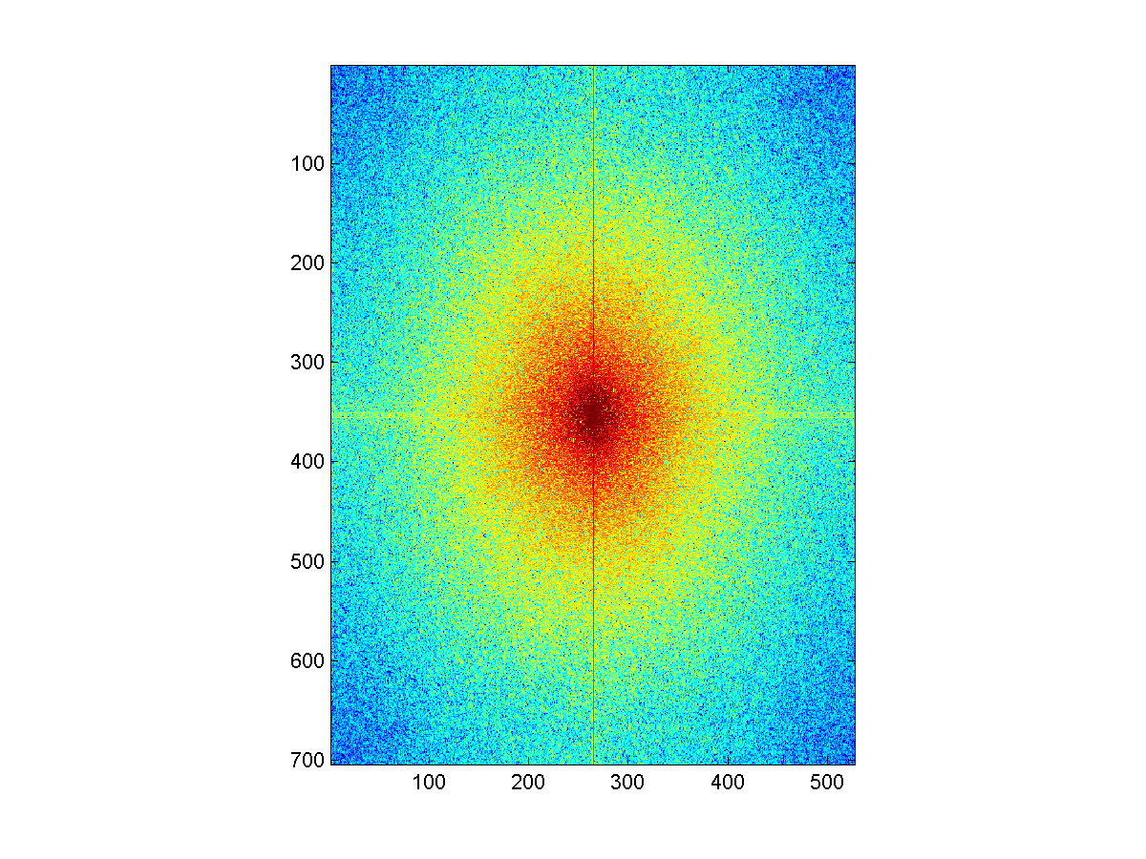
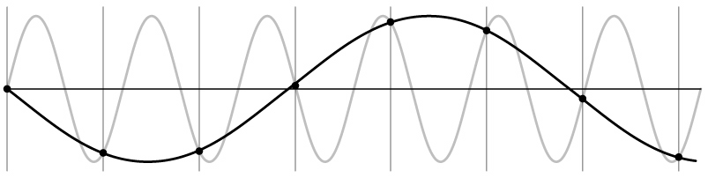
Things to Remember
Sometimes it makes sense to think of images and filtering in the frequency domain
Fourier analysis
Can be faster to filter using FFT for large images
N logN vs. N² for auto-correlation
Images are mostly smooth
Basis for compression
Remember to low-pass before sampling
Otherwise you create aliasing
Hays

Slide 7
Previous Lectures
We’ve now touched on the first three chapters of Szeliski.
1. Introduction
2. Image Formation
3. Image Processing
Now we’re moving on to
4. Feature Detection and Matching
Multiple views and motion (7, 8, 11)

Slide 8
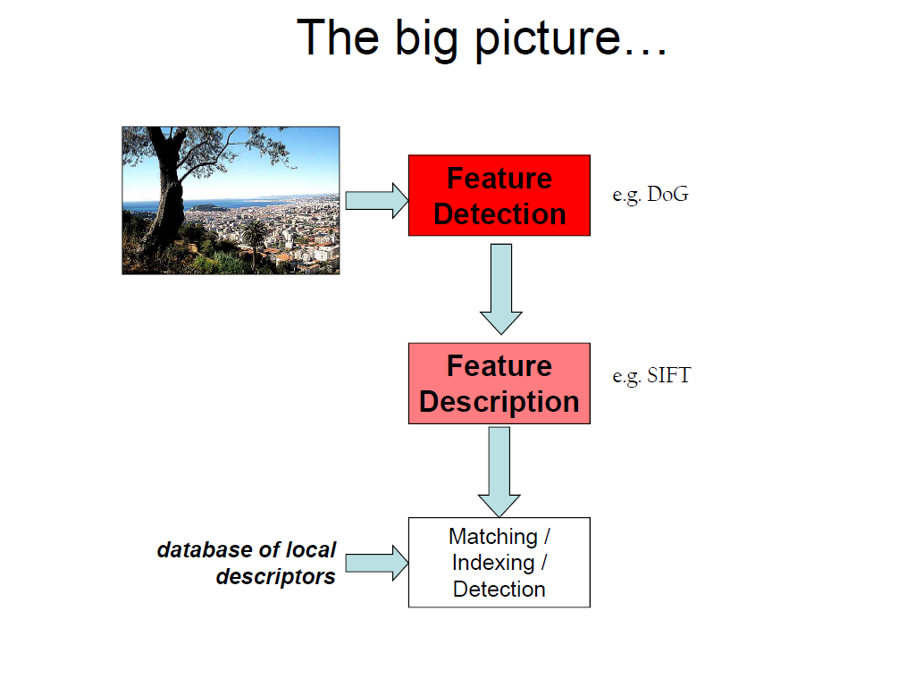
Fei Fei Li

Slide 9
Edge / Boundary Detection
Szeliski 4.2
Many slides from James Hays, Lana Lazebnik, Steve Seitz, David Forsyth, David Lowe, Fei-Fei Li, and Derek Hoiem

Slide 10
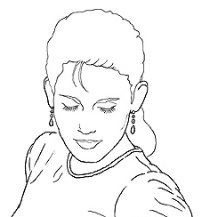
Edge detection
Goal: Identify visual changes (discontinuities) in an image.
Intuitively, semantic information is encoded in edges.
What are some ‘causes’ of visual edges?
Source: D. Lowe

Slide 11

Origin of Edges
surface normal discontinuity
depth discontinuity
surface color discontinuity
illumination discontinuity
Edges are caused by a variety of factors
Source: Steve Seitz

Slide 12
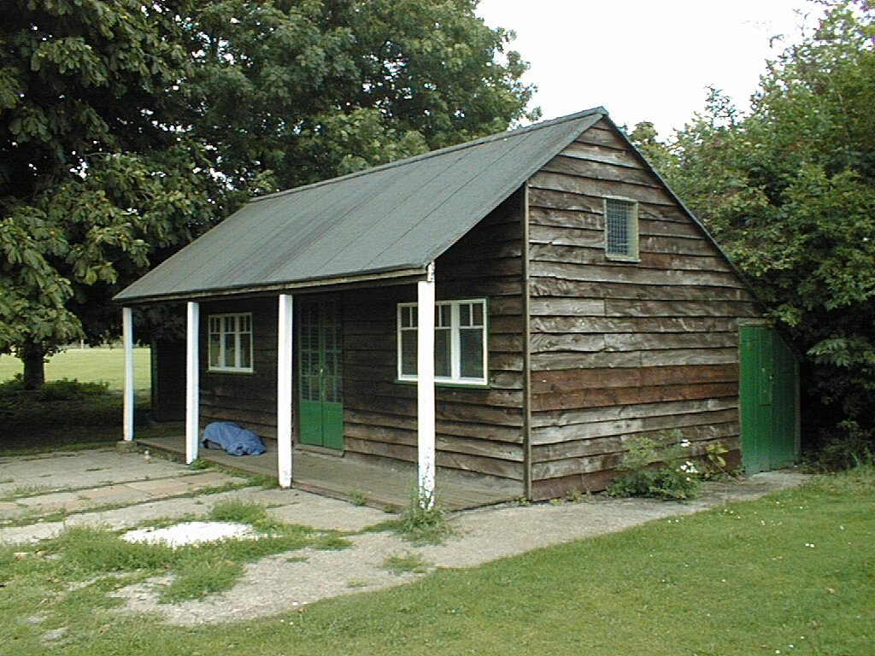
Why do we care about edges?
Extract information
Recognize objects
Help recover geometry and viewpoint
Vertical vanishing
point
(at infinity)
Vanishing
line
Vanishing
point
Vanishing
point

Slide 13
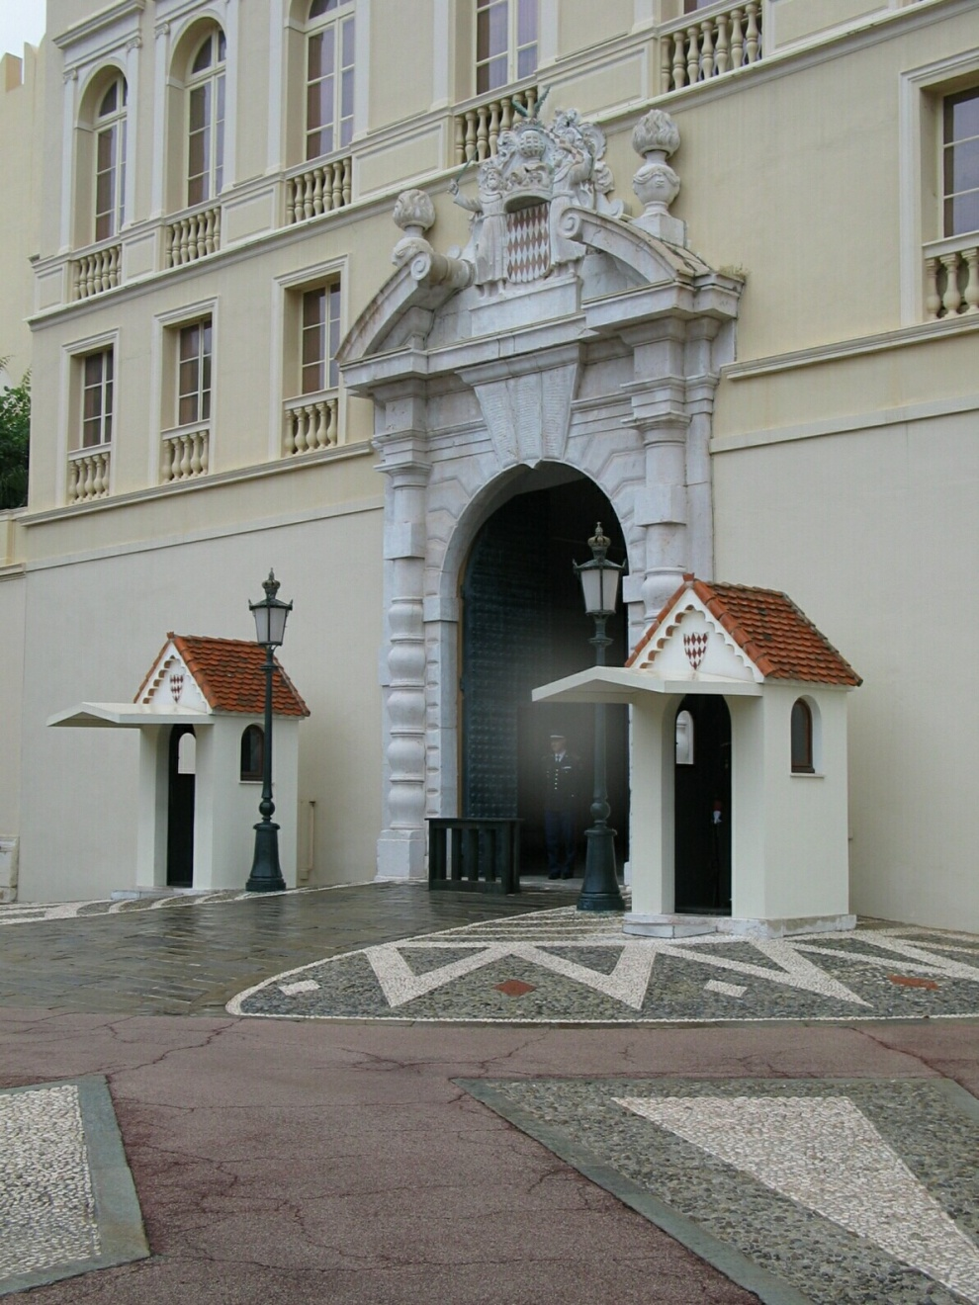
Closeup of edges
Source: D. Hoiem

Slide 14
Closeup of edges
Source: D. Hoiem

Slide 15
Closeup of edges
Source: D. Hoiem

Slide 16
Closeup of edges
Source: D. Hoiem

Slide 17

Characterizing edges
An edge is a place of rapid change in the image intensity function
intensity function (along horizontal scanline)
image
first derivative
edges correspond to extrema of derivative
Hays

Slide 18
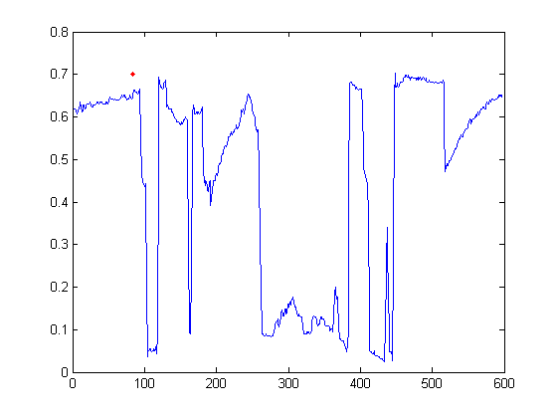

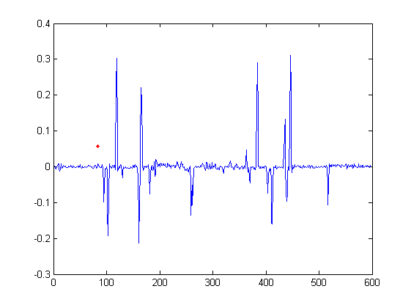
Intensity profile
Source: D. Hoiem

Slide 19
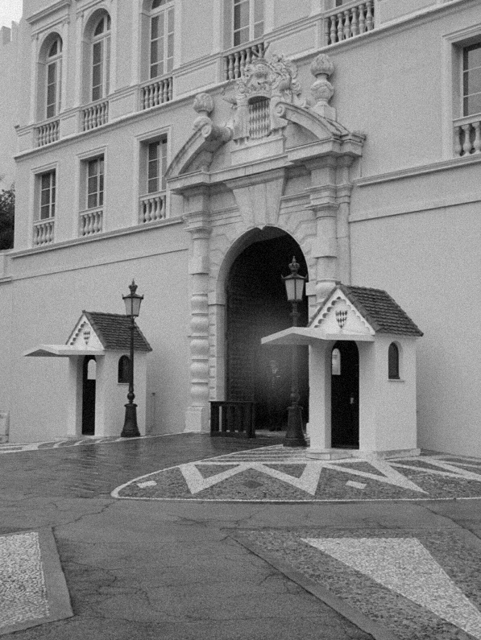
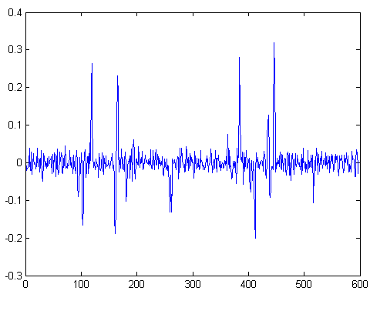
With a little Gaussian noise
Gradient
Source: D. Hoiem

Slide 20
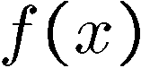
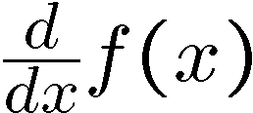
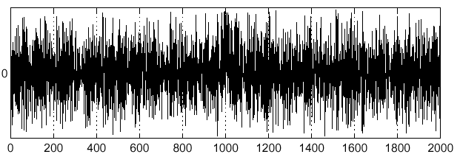
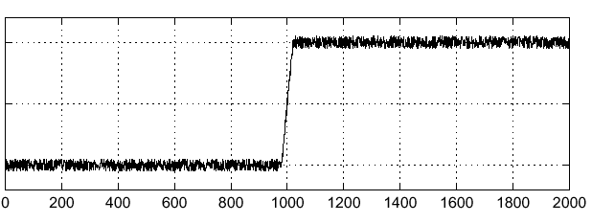
Effects of noise
Consider a single row or column of the image
Plotting intensity as a function of position gives a signal
Where is the edge?
Source: S. Seitz
Notes:
How to fix?

Slide 21
Effects of noise
Difference filters respond strongly to noise
Image noise results in pixels that look very different from their neighbors
Generally, the larger the noise the stronger the response
What can we do about it?
Source: D. Forsyth

Slide 22
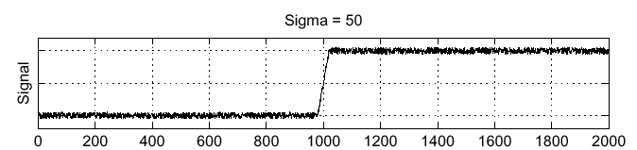
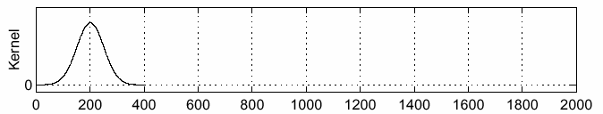
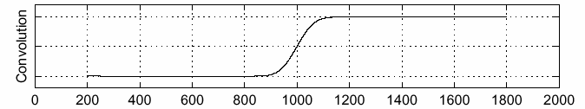
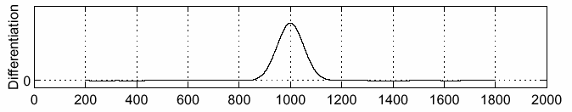
Solution: smooth first
f
g
f * g
To find edges, look for peaks in
Source: S. Seitz

Slide 23
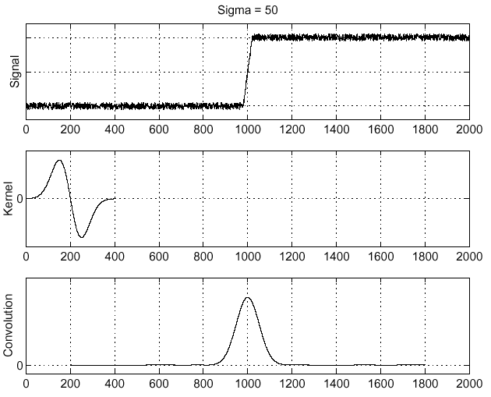
Derivative theorem of convolution
Convolution is differentiable:
This saves us one operation:
f
Source: S. Seitz
Notes:
One student question: “Why don’t we have to apply the chain rule?”
We have d/dx ( f * g ) where f and g are functions, and * is convolution. This represents the continuous case in 1D. We see this identity: d/dx (f * g) = f * dg/fx
Due to the commutativity of convolution, this is also true: d/dx (g * f) = f * dg/fx Or equally: d/dx (f * g) = df/fx * g
The derivative of a convolution of two functions is equal to the derivative of either of the functions convolved with the other function. This also holds for partial derivatives (for 2D convolution).
Let's look at the 1D continuous convolution case again. We didn't define it in lecture, but let's do it now. Convolution is an definite integral (our product in discrete case):
(f * g)(x) = INT( f(k)g(x-k) )dk | k=-inf to k=inf where x is our domain, and k is our dummy variable that slides f over g. Loosely, g would be our image, and f our filter.
So, when we want d/dx, we're differentiating an integral.
d/dx (f * g)(x) = d/dx INT( f(k)g(x-k)dk ) | k=-inf to k=inf
By the Liebniz rule (differentiation under the integral), as our kernel doesn't depend on x, we can bring the (now partial) derivative inside the integrand.
d/dx (f * g)(x) = INT( f(k) ∂/∂x g(x-k)dk ) | k=-inf to k=inf
Which is f * dg/dx.
The proof for the discrete case with the finite difference operator D can be found similarly (as in Section D.2.4 below), along with proofs of many of the other properties of convolutions. http://web.eecs.utk.edu/~roberts/WebAppendices/D-ConvProperties.pdf Thanks to Prof. Michael Roberts at UTK for this document. Note that Prof. Roberts is in EECS, and is used to convolving time series, so x is usually t.
Thanks, James

Slide 24
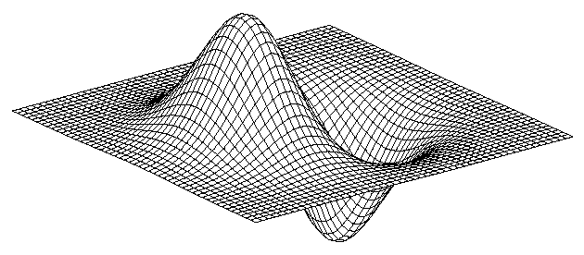
Derivative of 2D Gaussian filter
* [1 -1] =
Hays
Notes:
Is this filter separable?

Slide 25
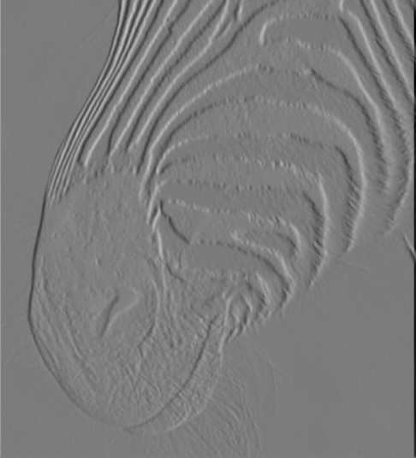
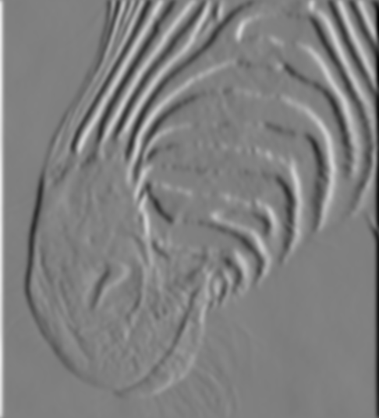
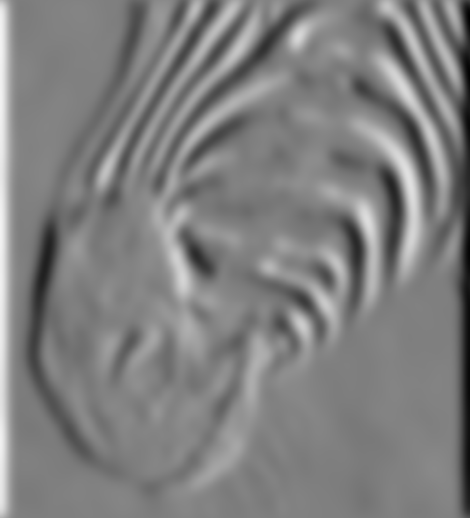
Tradeoff between smoothing and localization
1 pixel
3 pixels
7 pixels
Smoothed derivative removes noise, but blurs edge. Also finds edges at different “scales”.
Source: D. Forsyth

Slide 26
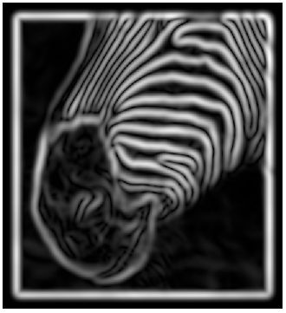
Implementation issues
The gradient magnitude is large along a thick “trail” or “ridge,” so how do we identify the actual edge points?
How do we link the edge points to form curves?
Source: D. Forsyth
Notes:
Figures show gradient magnitude of zebra at two different scales

Slide 27
Think-Pair-Share
What is a good edge detector?
Do we lose information when we look at edges? Are edges ‘complete’ as a representation of images?

Slide 28
Designing an edge detector
Criteria for a good edge detector:
Good detection: the optimal detector should find all real edges, ignoring noise or other artifacts
Good localization
the edges detected must be as close as possible to the true edges
the detector must return one point only for each true edge point
Cues of edge detection
Differences in color, intensity, or texture across the boundary
Continuity and closure
High-level knowledge
Source: L. Fei-Fei

Slide 29
Designing an edge detector
“All real edges”
We can aim to differentiate later on which edges are ‘useful’ for our applications.
If we can’t find all things which could be called an edge, we don’t have that choice.
Is this possible?

Slide 30
Closeup of edges
Source: D. Hoiem

Slide 31
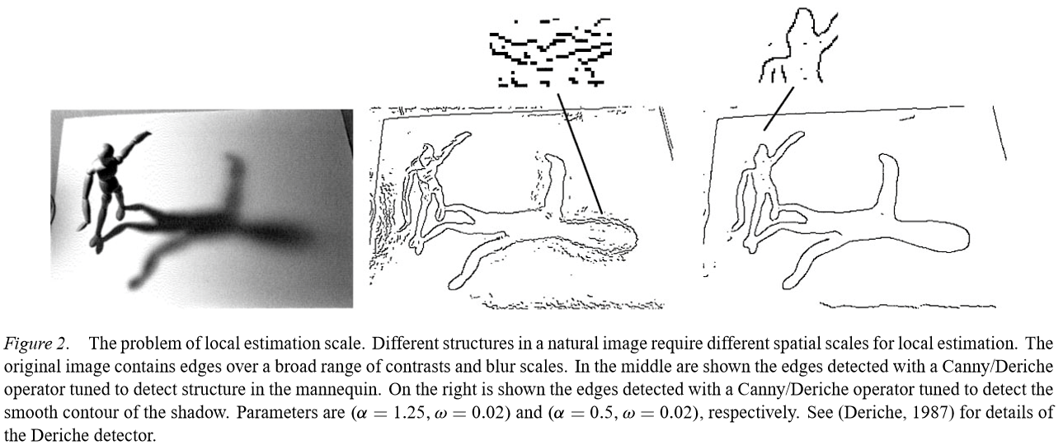
Elder – Are Edges Incomplete? 1999
What information would we need to ‘invert’ the edge detection process?

Slide 32
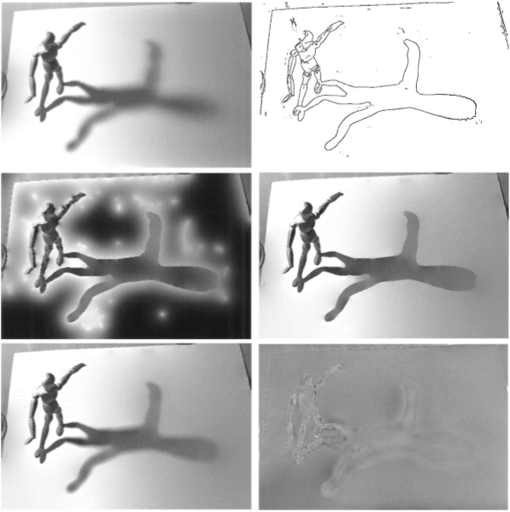
Elder – Are Edges Incomplete? 1999
Edge ‘code’:
position,
gradient magnitude,
gradient direction,
blur.
Notes:
http://link.springer.com/article/10.1023%2FA%3A1008183703117

Slide 33
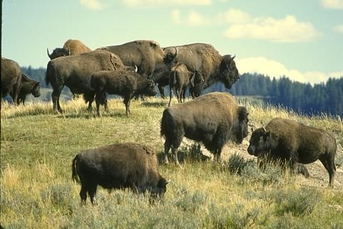
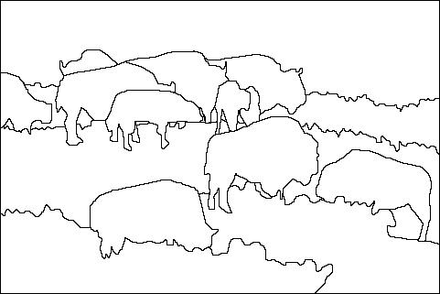
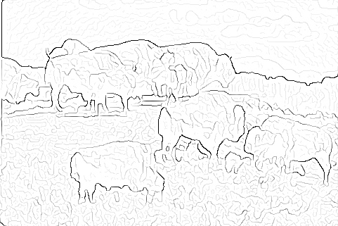

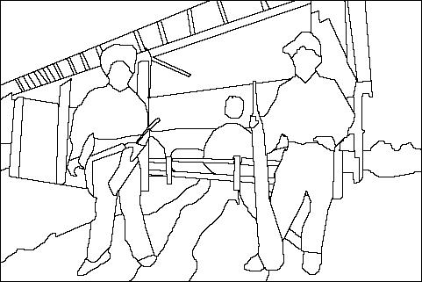
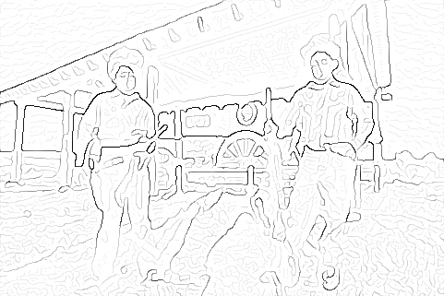
Where do humans see boundaries?
image
human segmentation
gradient magnitude
Berkeley segmentation database: http://www.eecs.berkeley.edu/Research/Projects/CS/vision/grouping/segbench/
pB slides: Hays

Slide 34
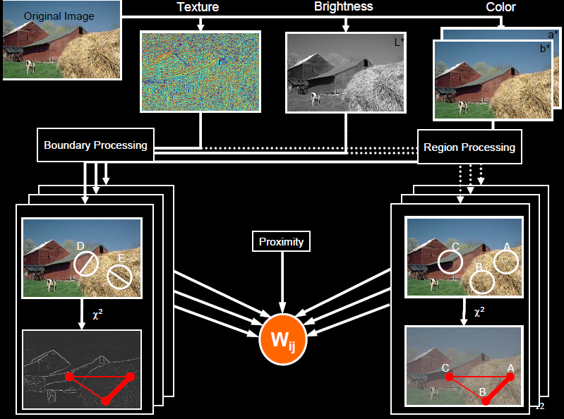
pB boundary detector
Martin, Fowlkes, Malik 2004: Learning to Detect Natural Boundaries…
http://www.eecs.berkeley.edu/Research/Projects/CS/vision/grouping/papers/mfm-pami-boundary.pdf
Figure from Fowlkes

Slide 35
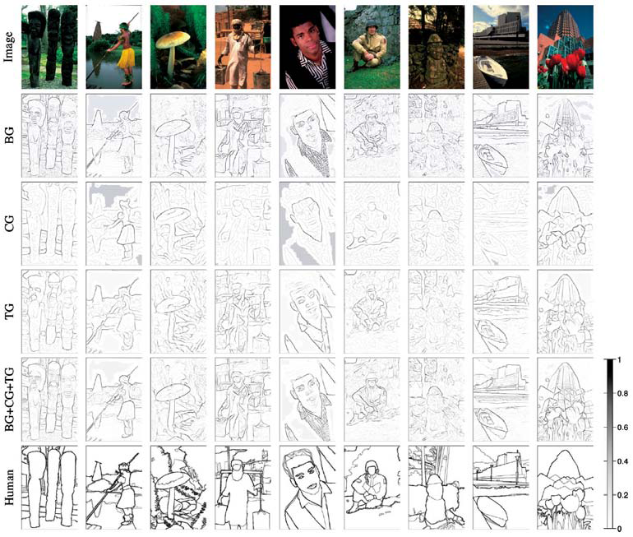
Brightness
Color
Texture
Combined
Human

Slide 36
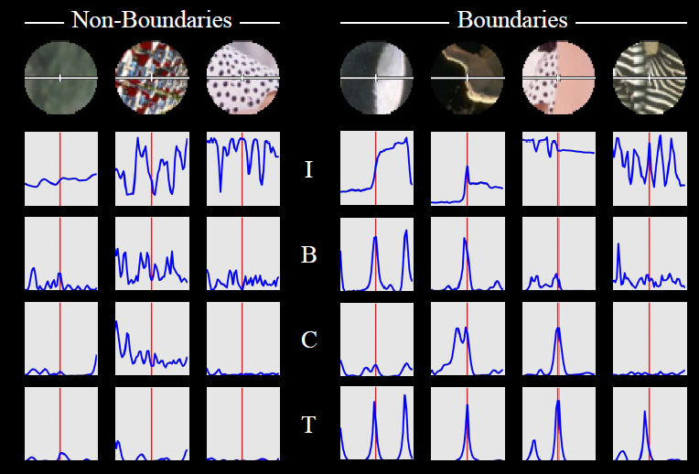
pB Boundary Detector
Figure from Fowlkes

Slide 37
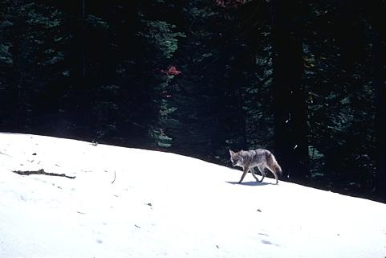
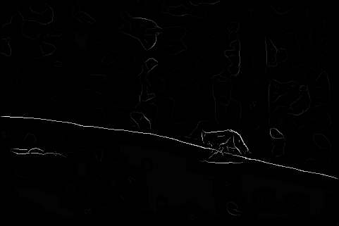
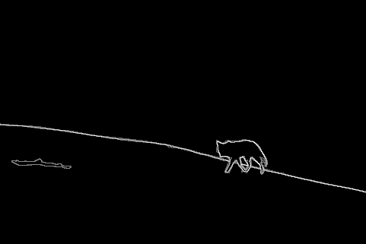
Results
Pb (0.88)
Human (0.95)

Slide 38
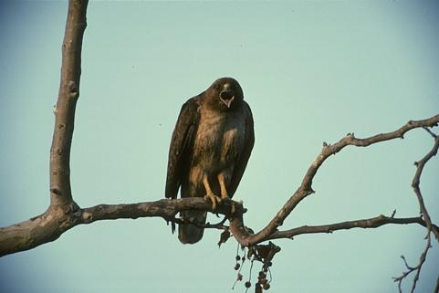
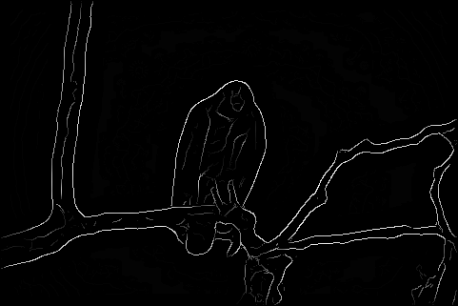
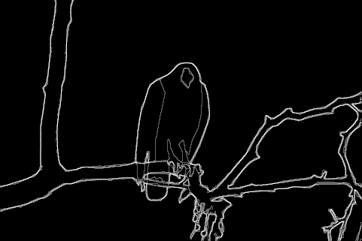
Results
Pb
Pb (0.88)
Global Pb
Human
Human (0.96)

Slide 39
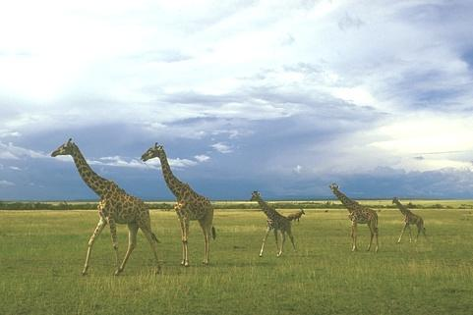
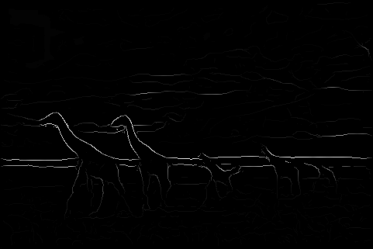
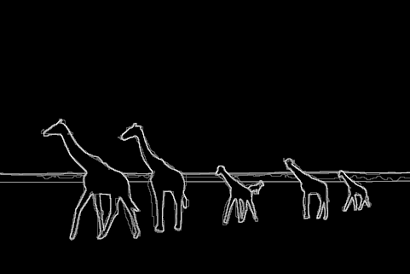
Pb (0.63)
Human (0.95)

Slide 40



Pb (0.35)
Human (0.90)
For more: http://www.eecs.berkeley.edu/Research/Projects/CS/vision/bsds/bench/html/108082-color.html

Slide 41

Global pB boundary detector
Figure from Fowlkes

Slide 42

45 years of boundary detection
Source: Arbelaez, Maire, Fowlkes, and Malik. TPAMI 2011 (pdf)

Slide 43
State of edge detection
Local edge detection works well
‘False positives’ from illumination and texture edges (depends on our application).
Some methods to take into account longer contours
Modern methods that actually “learn” from data.
Poor use of object and high-level information.
Hays

Slide 44
Summary: Edges primer
Edge detection to identify visual change in image
Derivative of Gaussian and linear combination of convolutions
What is an edge? What is a good edge?
f

Slide 45
Canny edge detector
Probably the most widely used edge detector in computer vision.
Theoretical model: step-edges corrupted by additive Gaussian noise.
Canny showed that first derivative of Gaussian closely approximates the operator that optimizes the product of signal-to-noise ratio and localization.
J. Canny, A Computational Approach To Edge Detection, IEEE Trans. Pattern Analysis and Machine Intelligence, 8:679-714, 1986.
22,000 citations!
L. Fei-Fei

Slide 46


Demonstrator Image
rgb2gray(‘img.png’)
Notes:
“Asian Business Woman 2” by Bold Content is licensed under CC BY 2.0

Slide 47
Canny edge detector
Filter image with x, y derivatives of Gaussian
Source: D. Lowe, L. Fei-Fei

Slide 48


Derivative of Gaussian filter
x-direction
y-direction

Slide 49



Compute Gradients
X Derivative of Gaussian
Y Derivative of Gaussian
(x2 + 0.5 for visualization)

Slide 50
Canny edge detector
Filter image with x, y derivatives of Gaussian
Find magnitude and orientation of gradient
Source: D. Lowe, L. Fei-Fei

Slide 51

Compute Gradient Magnitude
sqrt( XDerivOfGaussian .^2 + YDerivOfGaussian .^2 ) = gradient magnitude
(x4 for visualization)

Slide 52


Compute Gradient Orientation
Threshold magnitude at minimum level
Get orientation via
theta = atan2(gy, gx)
Unthresholded:

Slide 53
Canny edge detector
Filter image with x, y derivatives of Gaussian
Find magnitude and orientation of gradient
Non-maximum suppression:
Thin multi-pixel wide “ridges” to single pixel width
Source: D. Lowe, L. Fei-Fei

Slide 54


Non-maximum suppression for each orientation
At pixel q:
We have a maximum if the value is larger than those at both p and at r.
Interpolate along gradient direction to get these values.
Source: D. Forsyth

Slide 55

Before Non-max Suppression
Gradient magnitude (x4 for visualization)

Slide 56

After non-max suppression
Gradient magnitude (x4 for visualization)

Slide 57
Canny edge detector
Filter image with x, y derivatives of Gaussian
Find magnitude and orientation of gradient
Non-maximum suppression:
Thin multi-pixel wide “ridges” to single pixel width
‘Hysteresis’ Thresholding
Source: D. Lowe, L. Fei-Fei
Notes:
Hysteresis is the dependence of the state of a system on its history -> bad word to use in this sense (comes from engineering)

Slide 58
Edge linking
Assume the marked point is an edge point. Then we construct the tangent to the edge curve (which is normal to the gradient at that point) and use this to predict the next points (here either r or s).
Source: D. Forsyth

Slide 59
‘Hysteresis’ thresholding
Two thresholds – high and low
Grad. mag. > high threshold? = strong edge
Grad. mag. < low threshold? noise
In between = weak edge
‘Follow’ edges starting from strong edge pixels
Continue them into weak edges
Connected components (Szeliski 3.3.4)
Source: S. Seitz

Slide 60


Final Canny Edges
$$σ=\sqrt{2}, t_{low}=0.05,t_{high}=0.1$$

Slide 61




Effect of σ (Gaussian kernel spread/size)
Original
$$σ=\sqrt{2}$$
$$σ=4\sqrt{2}$$
The choice of σ depends on desired behavior
large σ detects large scale edges
small σ detects fine features
Source: S. Seitz

Slide 62
Canny edge detector
Filter image with x, y derivatives of Gaussian
Find magnitude and orientation of gradient
Non-maximum suppression:
Thin multi-pixel wide “ridges” to single pixel width
‘Hysteresis’ Thresholding:
Define two thresholds: low and high
Use the high threshold to start edge curves and the low threshold to continue them
‘Follow’ edges starting from strong edge pixels
Connected components (Szeliski 3.3.4)
MATLAB: edge(image, ‘canny’)
Source: D. Lowe, L. Fei-Fei

Slide 63



Sidebar: Bilinear Interpolation
http://en.wikipedia.org/wiki/Bilinear_interpolation

Slide 64



Sidebar: Interpolation options
imx2 = imresize(im, 2, interpolation_type)
‘nearest’
Copy value from nearest known
Very fast but creates blocky edges
‘bilinear’
Weighted average from four nearest known pixels
Fast and reasonable results
‘bicubic’ (default)
Non-linear smoothing over larger area (4x4)
Slower, visually appealing, may create negative pixel values
Examples from http://en.wikipedia.org/wiki/Bicubic_interpolation

